Slide 1
Attrition Analysis
Dheeraj Vempaty
- Dheeraj Vempaty
Notes:
A finished project is valued much more than an unfinished one done alone.

Slide 2
Objective
Analyze employee data to identify key factors impacting attrition and recommend actionable strategies to improve retention.
Dheeraj Vempaty

Slide 3
Data Cleaning and Preparation
Took a backup of the original table and removed duplicates and non-numeric Employee IDs.
Filtered rows with “NA” while analyzing the Survey ratings vs Attrition for cleaner output.
Joined general_data with survey tables to create a unified dataset.
Dheeraj Vempaty

Slide 4
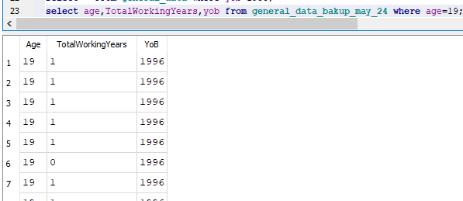
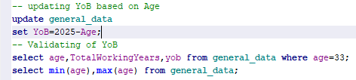
Data Cleaning and Preparation
Derived Fields: Year of Birth (YoB) did not match Age or Experience. Updated YoB based on Age to ensure consistency.
Dheeraj Vempaty

Slide 5
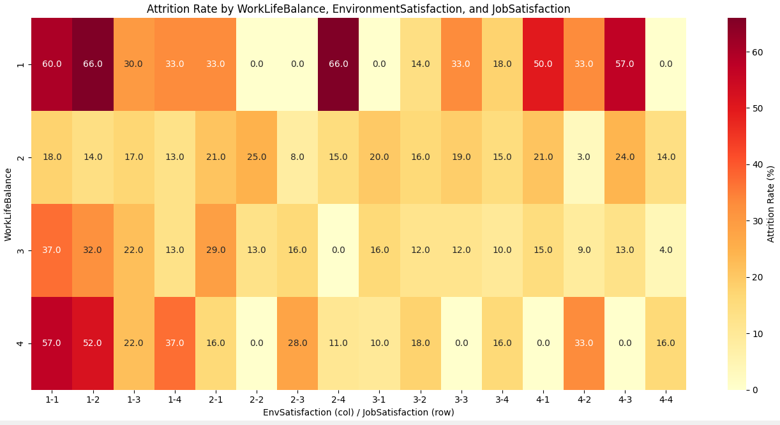

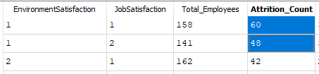
Observations
Survey Feedback :
WorkLifeBalance = 1 showed the highest attrition rate at 31.4%.
EnvironmentSatisfaction = 1 and JobSatisfaction = 1 also show elevated attrition (~25%+).
Dheeraj Vempaty

Slide 6
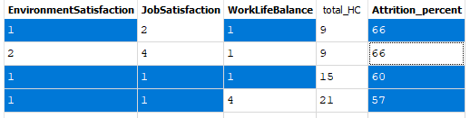
Observations
Dheeraj Vempaty
Survey Feedback :
Attrition spikes when multiple low survey ratings occur together.
Employees with low satisfaction and poor work-life balance are at the highest risk of leaving.

Slide 7
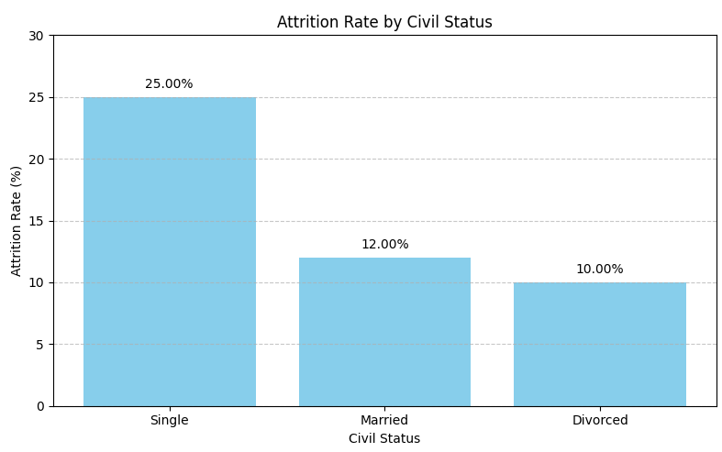
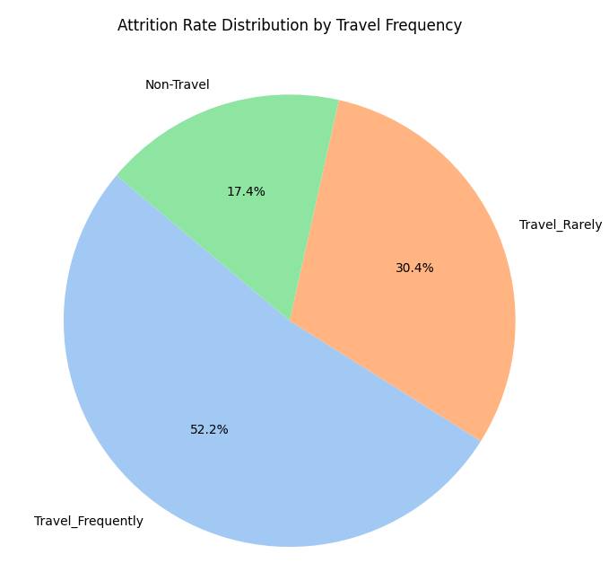
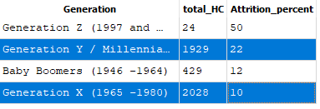
Observations
Demographic & Job Role:
Single employees have a 57% higher attrition rate compared to the overall average(16%), and over 2X higher than married employees.
Generation Y (Millennials) are more likely to leave than Generation X.
Frequent travelers show higher attrition rate than those who travel rarely.
Dheeraj Vempaty

Slide 8
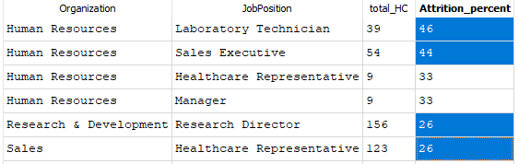
Observations
Demographic & Job Role:
Human Resources department shows particularly high attrition in technician/sales roles.
R&D roles, like Research Director, show significant attrition.
Dheeraj Vempaty

Slide 9
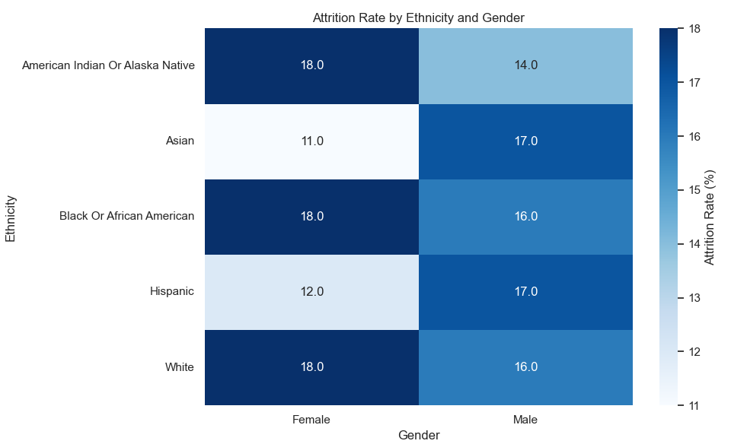
Observations
Ethnicity & Gender:
Minor differences exist across ethnicity and gender groups, they do not significantly drive attrition compared to work experience, role dynamics, and employee satisfaction.
Dheeraj Vempaty

Slide 10
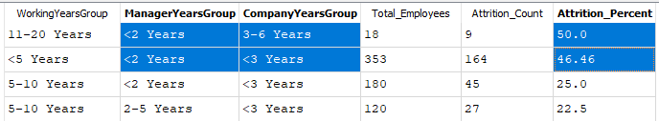
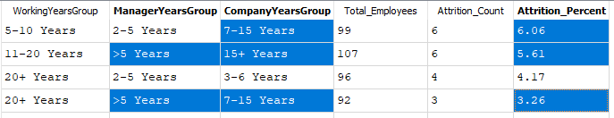
Observations
Years of Experience:
Employees with <2 years under their manager face attrition rates up to 50%.
Employees with longer tenure at the company and stable manager show much lower attrition.
Dheeraj Vempaty

Slide 11
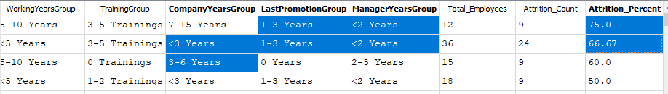
Observations
Years of Experience:
Shorter tenure with the company and manager, especially when combined with recent promotions significantly increases Attrition risk.
Salary/Stocks/Hike:
Salary is not a strong retention lever—non-monetary factors dominate.
High salary or large raises do not guarantee retention.
Dheeraj Vempaty

Slide 12
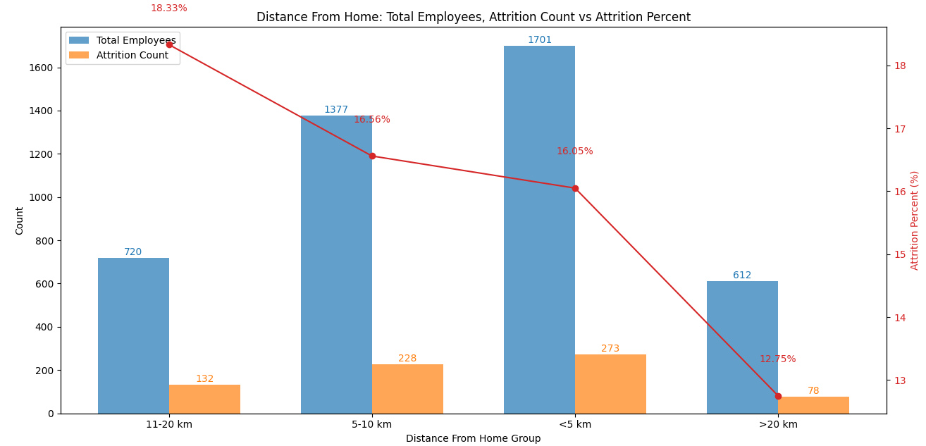
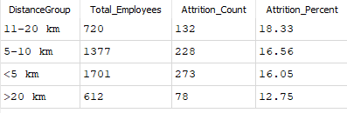
Observations
Commute to Office:
Majority of employees live within 5 km of the office, and attrition rates for those with short (<5 km) or mid-range (5–20 km) commutes are comparable, ranging between 16%–18%.
This suggests that Proximity to office has minimal influence on attrition (~16–18% regardless of distance).
Dheeraj Vempaty

Slide 13
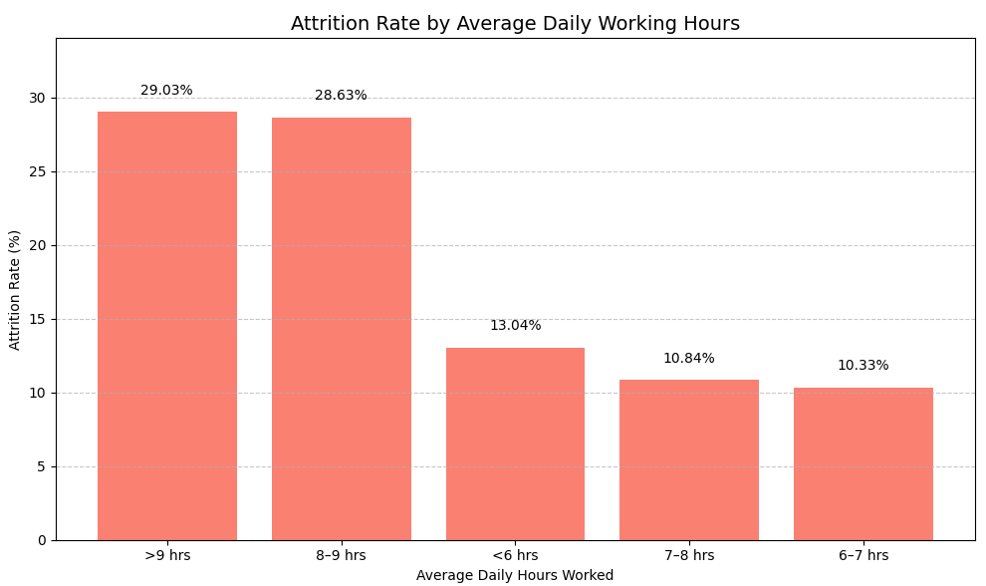
Observations
Time Spent in Office:
Employees working >8 hours per day have a much higher attrition rate (~29%).
Those working a balanced 6–8 hours per day show the lowest attrition (~10%).
Dheeraj Vempaty

Slide 14
Insights Summary
Poor Work-Life Balance (31.4% attrition)
Low Environment/Job Satisfaction (25–26%)
Short Tenure with Manager & Recent Promotions (<2 years → up to 50%)
Frequent travelers show more attrition than rare or non-travelers
High Working Hours (>8 hrs/day → 29%)
Salary, Ethnicity, Gender and Office Commute Distance are not strong drivers of attrition.
Dheeraj Vempaty

Slide 15
Recommendations
Work-Life Balance: Roll out flexible schedules or hybrid models.
Targeted Engagement: Focus retention programs on Millennials and single employees.
Support Early-Stage Manager Relationships (<2 years) to reduce 50%+ attrition risk.
Monitor & Manage High-Risk Roles – Some roles have 20%+ attrition despite good compensation.
Dheeraj Vempaty

Slide 16
Data Enhancements for Better Attrition Insights
Few high-value dimensions to add on current dataset for strengthen insights, KPIs, and decision-making:
Attrition Type - Voluntary vs. Involuntary
Exit Reason - Better offer, relocation, manager issues, burnout etc.,.
Team Size / Span of Control
Retention Risk
Dheeraj Vempaty

